Slide 1

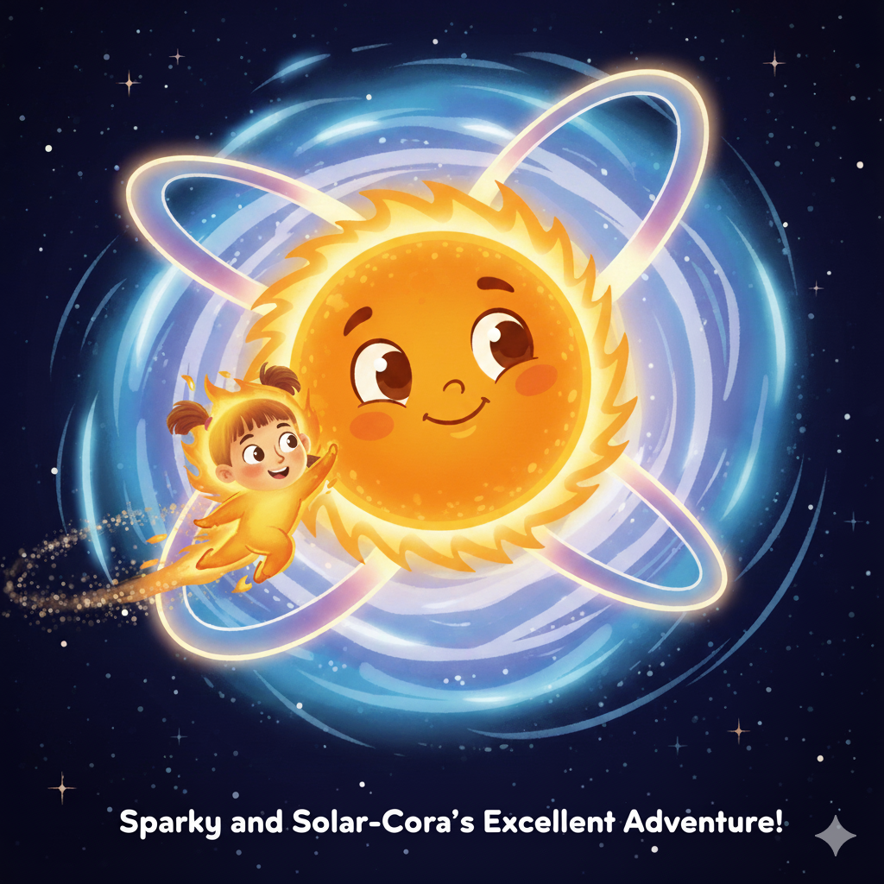
SPARKY AND SOLAR-CORA’S EXCELLENT ADVENTURE

Slide 2
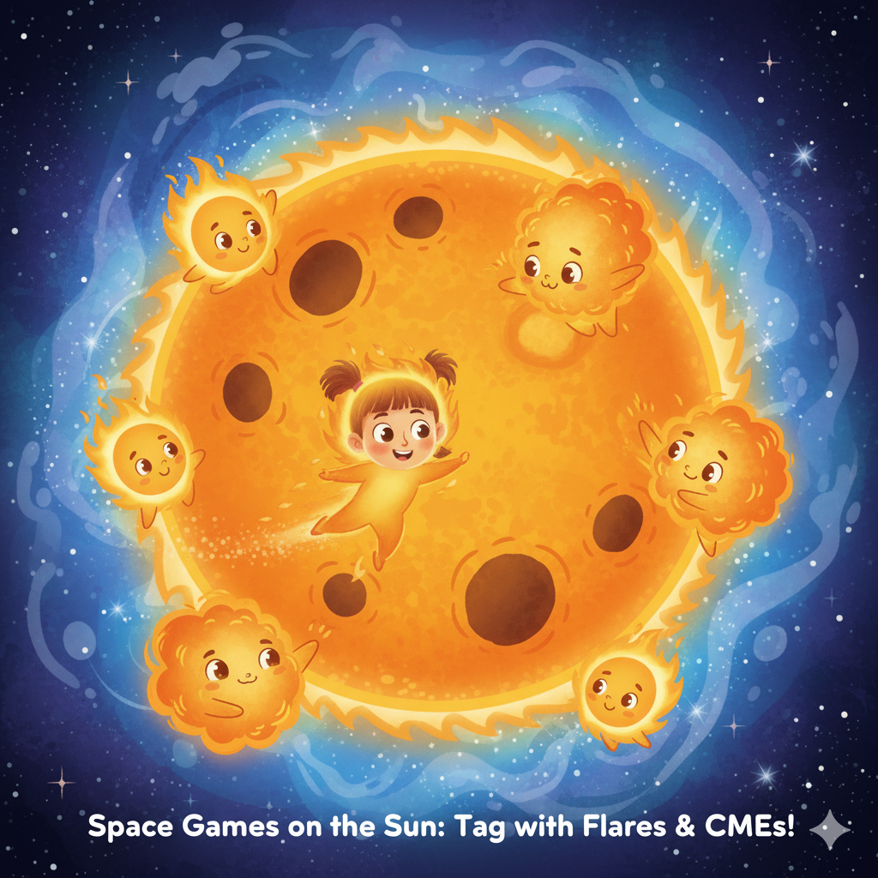
Hi there! My name’s Fiona the Fiery Flare, and I live on the Sun .Every day, the Sun shines bright and warms all the planets. But sometimes, the Sun gets super active — that’s when space weather begins!

Slide 3

I’m a Coronal Mass Ejection, but you can call me Corona for short.A CME is a huge bubble of gas and magnetic energy that bursts out of the Sun’s outer layer — the corona (that’s where I got my name!.

Slide 4
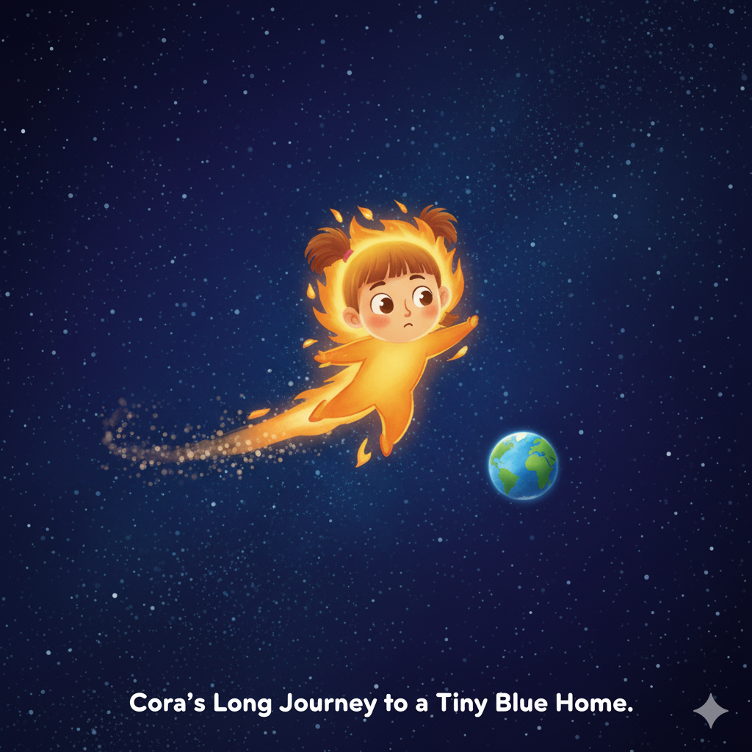
Down below, Earth spins happily with its blue oceans and white clouds.But I’m not just coming for a visit — I bring space weather .That means solar flares, solar wind, and sometimes, huge coronal mass ejections (CMEs) — like me!

Slide 5
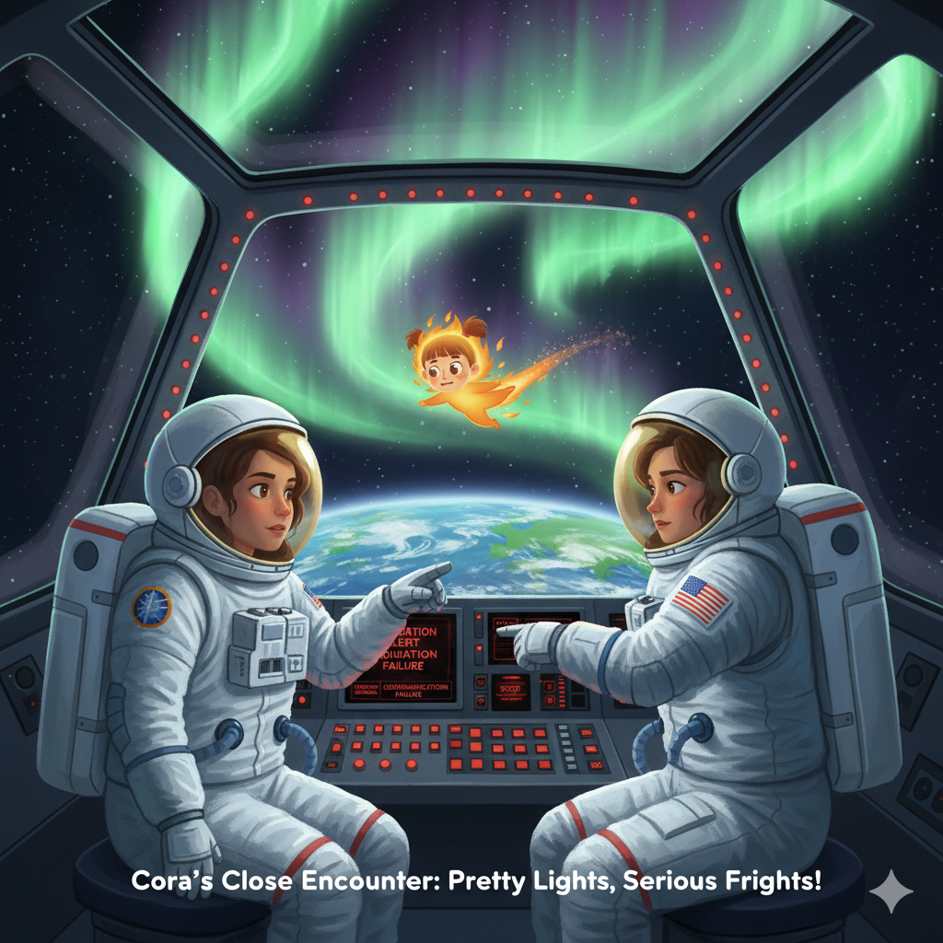
“Uh oh!” says an astronaut on the space station.“When Sunny arrives, we’ll stay in a safe shielded room.”My energy can hurt satellites and even astronauts’ equipment!

Slide 6
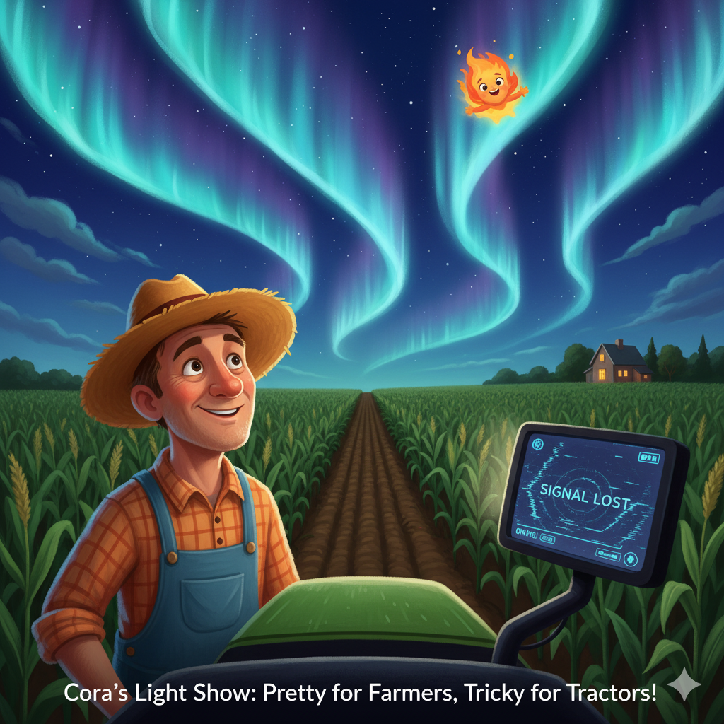
Even farmers feel my power! When space weather messes with GPS, their tractor maps can get confused.But I also make beautiful auroras that dance in the night sky!

Slide 7
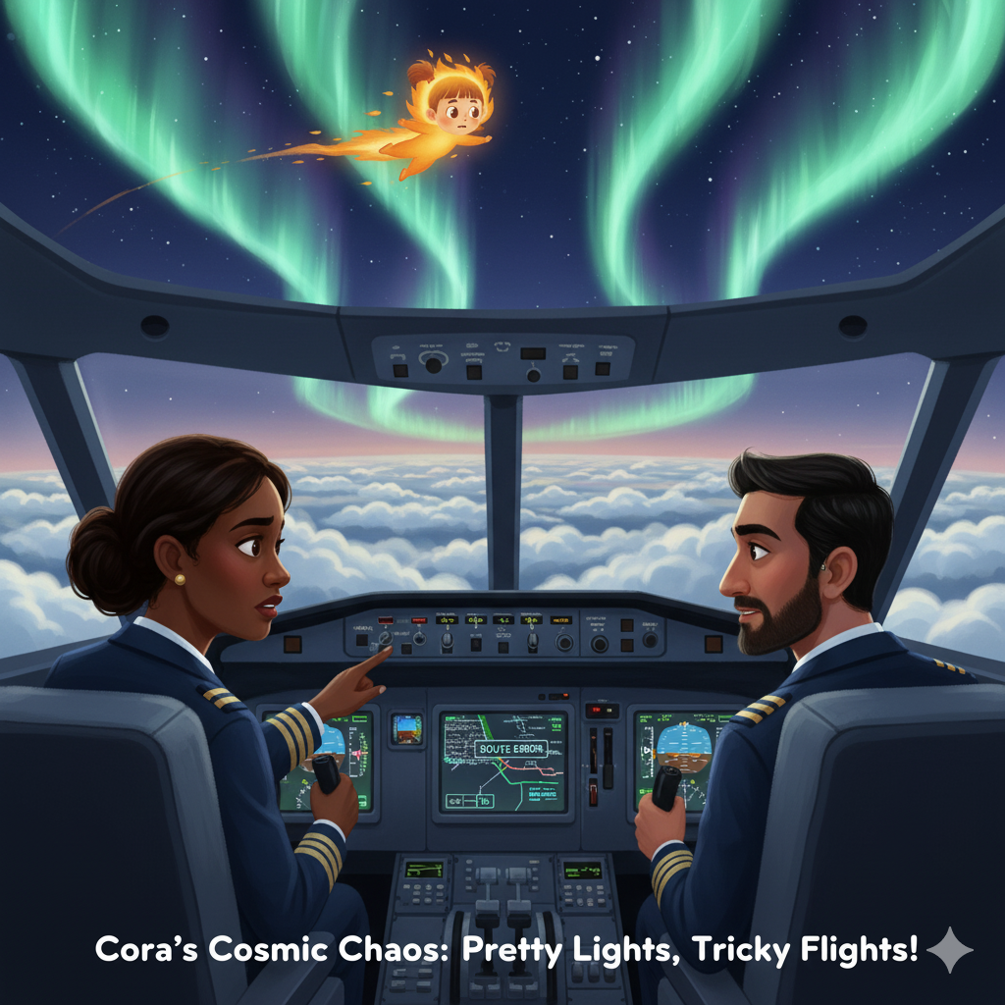
Down on Earth, pilots flying near the North Pole get a message:“Warning! Solar storm ahead — GPS signals may go fuzzy!”My charged particles can make radio and GPS stop working for a bit.

Slide 8
